Slide 1
UIDAI Hackathon
Team Reference ID : Yv76hUyH4p
Team Member Details
Sl No | Name | E Mail ID
1 | ISHAN DWIVEDI | dwivedi.ishan@gmail.com
2 3 | MAHANTESH MASALI MANISH GOWDA NS | vishalmasali759@gmail.com manishgowdans2002@gmail.com

Slide 2
About the Problem Statement
Theme : Address Update
Problem Statement:
Address Update Challenge in Urban Areas

Slide 3
Approach
The approach to the project is based on 3 steps of verification
Where the landlord verifies the person with his address verified Aadhar
There will be an OTP sent on both the users and when the OTP is verified on both ends the next step of the process takes place
When the details are being entered the GPS location has to be marked at the exact same place for the verification to take place
2. Uploading of necessary details like Lease and Transaction details regarding the tenants staying
3. Police Verification for final verification after which the verification process is complete

Slide 4
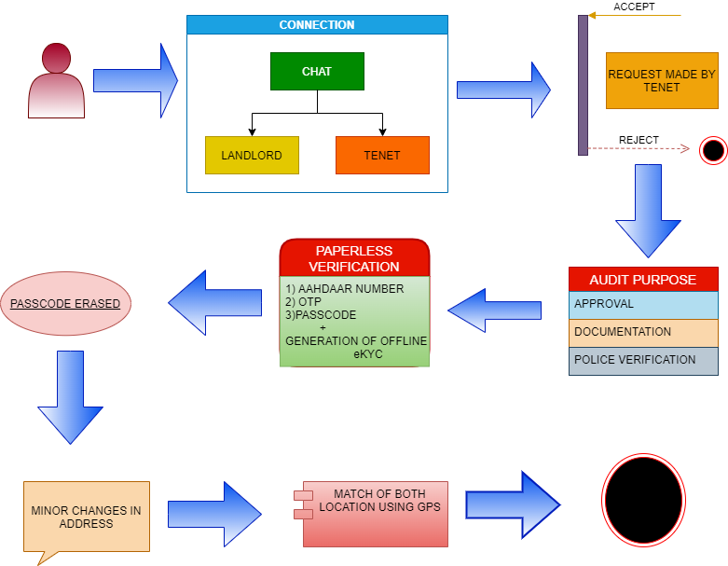
Architectural Diagram

Slide 5
API Usage
Offline eKYC API
OTP API
GPS API

Slide 6
Security Considerations
Using of police verification for identity verification (documents to be uploaded by the police who verified)
Using of OTP’s on both devices (the landlord and the migrant worker) for verification in the same portal (like in bluetooth pairing process)
The erasement of passcode after usage

